Slide 1
Text news classification
Using ML

Slide 2
SKLearn 20 news group data
The 20 newsgroups dataset comprises around 18000 newsgroups posts on 20 topics split in two subsets: one for training (or development) and the other one for testing (or for performance evaluation). The split between the train and test set is based upon a messages posted before and after a specific date.
from sklearn.datasets import fetch_20newsgroups is used to import and download the data .

Slide 3
Pandas library
Pandas is a software library written for the Python programming language for data manipulation and analysis.
Fast and efficient for manipulating and analyzing data.
Data set merging and joining.
Flexible reshaping and pivoting of data sets
And many others...

Slide 4
Train test split
In this dataset we were already given two subset namely train and test which contained different values for training and testing the data.
Train data: The data you use to train a machine learning algorithm or model. Training data requires some human involvement to analyze or process the data for machine learning use. Usually taken 80 percent of the entire dataset.
Test data: data which has been particularly distinguished for use in tests, to check the accuracy of an algorithm . This data is taken to be around 20 % and is entirely different from the train data.

Slide 5
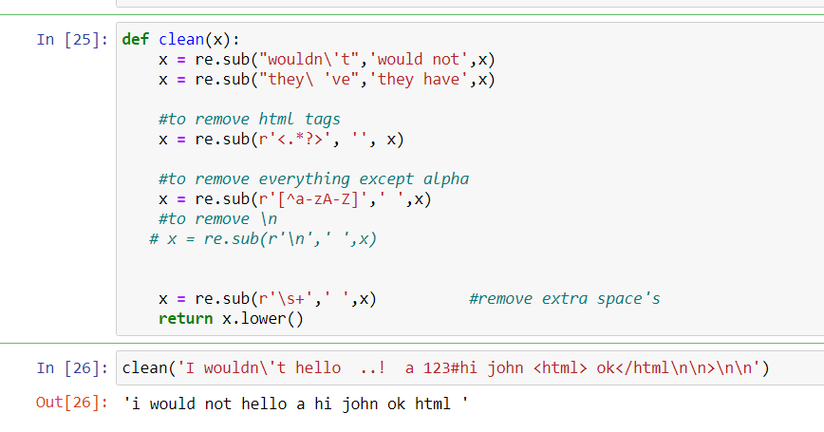
Data cleaning
It is the process of detecting and correcting (or removing) corrupt or inaccurate records from a record set, table, or database and refers to identifying incomplete, incorrect, inaccurate or irrelevant parts of the data and then replacing, modifying, or deleting the dirty or coarse data.
Here we have an example from my code :

Slide 6
Vectorization
Vectorization is used to speed up the Python code without using loop. Using such a function can help in minimizing the running time of code efficiently.
We have 3 text vectorizers :CountVectorizer, TfidfVectorizer, HashingVectorizer.I ve used tfidfVectorizer.
It is basically used to convert text data to a numerical representation ,hence we get an array after vectorizing a text.
For example: TfidfVectorizer will tokenize documents, learn the vocabulary and inverse document frequency weightings, and allow you to encode new documents.

Slide 7
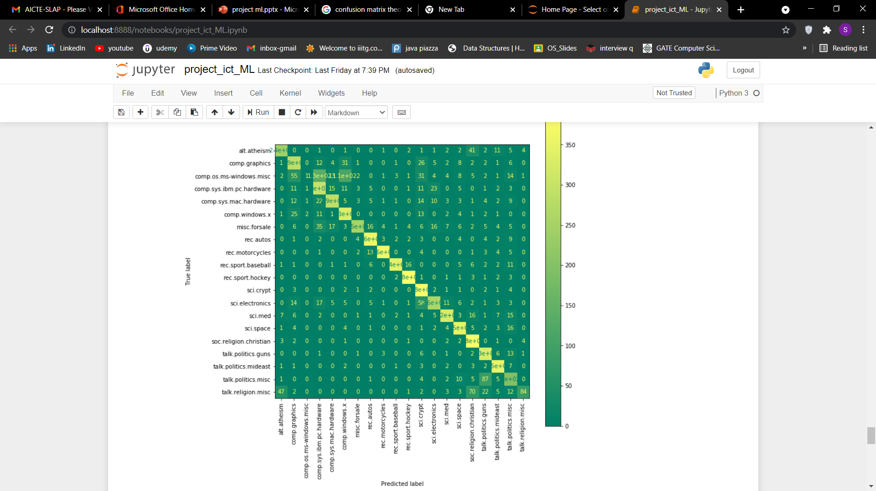
Confusion matrix
A confusion matrix is a summary of prediction results on a classification problem. The number of correct and incorrect predictions are summarized with count values and broken down by each class.
This is the key to the confusion matrix. is confused when it makes predictions.
Confusion matrix of logestic regression algorithm of my code

Slide 8
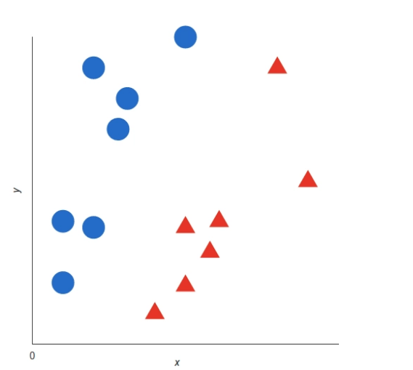
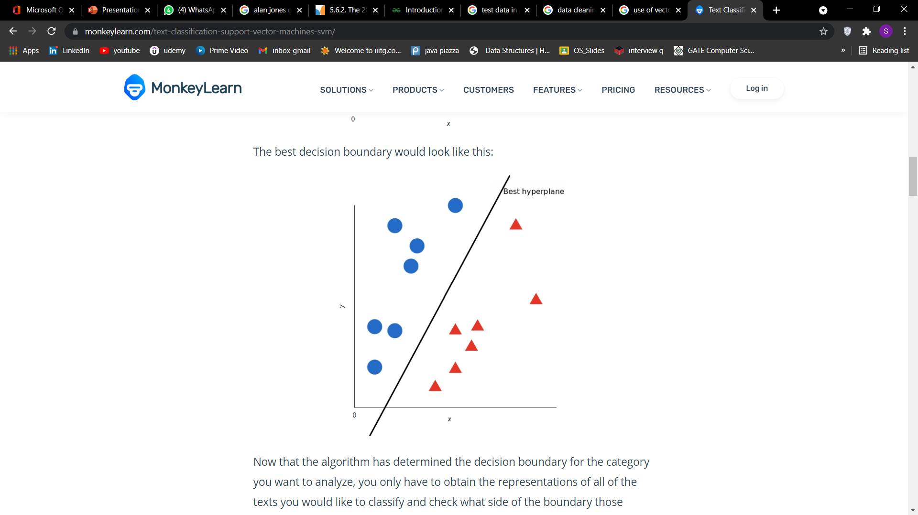
SVM
Support vector machines(SVM) is an algorithm that determines the best decision boundary between vectors that belong to a given group (or category) and vectors that do not belong to it.
For example, the blue circles in the graph below are representations of training texts which talk about the Pricing of a SaaS Product and the red triangles are representations of training texts which do not talk about that.

Slide 9
KNN
K-Nearest Neighbour is one of the simplest Machine Learning algorithms based on Supervised Learning technique.
K-NN algorithm assumes the similarity between the new case/data and available cases and put the new case into the category that is most similar to the available categories.
K-NN algorithm stores all the available data and classifies a new data point based on the similarity. This means when new data appears then it can be easily classified into a well suite category by using K- NN algorithm.
The algorithm is used to classify by finding the K nearest matches in training data and then using the label of closest matches to predict.

Slide 10
Naive bayes
This is the applied commonly to text classification that includes a high-dimensional training dataset.
Naïve Bayes Classifier is one of the simple and most effective Classification algorithms which helps in building the fast machine learning models that can make quick predictions.
It is a probabilistic classifier, which means it predicts on the basis of the probability of an object.
Some popular examples of Naïve Bayes Algorithm are spam filtration, Sentimental analysis, and classifying articles.

Slide 11
Logistic Regression
Logistic regression is a classification algorithm used to assign observations to a discrete set of classes. Some of the examples of classification problems are Email spam or not spam
Logistic regression transforms its output using the logistic sigmoid function to return a probability value.
it is a predictive analysis algorithm and based on the concept of probability.
In order to map predicted values to probabilities, we use the Sigmoid function. The function maps any real value into another value between 0 and 1. In machine learning, we use sigmoid to map predictions to probabilities.sigmoid:1/(1+e^(-z))

